Slide 1
What is a “Food System”?
Overview Pathway

Slide 2
What is a “food system”?
“a complex web of activities involving the production, processing, transport, and consumption” of food
Source: Oxfam global food challenge teacher overview, pg. 1

Slide 3
A “food system”…
“includes not only the basic elements of how we get our food from farm to fork, but also all of the processes and infrastructure involved in feeding a population.”
“Systems can also exist within systems, for example, farming systems, agricultural ecosystems, economic systems, and social systems and within those are further subsets of water systems, energy systems, financing systems, marketing systems, policy systems, culinary systems, and so on.”
Source: Oxford Martin Programme on the Future of Food

Slide 4
Food system challenges include:
the governance and economics of food production
its sustainability
the degree to which we waste food
how food production affects the natural environment
the impact of food on individual and population health
Source: The Oxford Martin Program

Slide 5
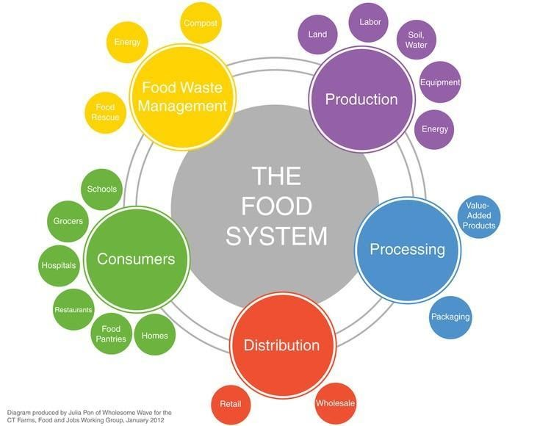
Five key elements: production, processing, distribution, consumers and food waste management.
Source: Oxford Martin Programme on the Future of Food

Slide 6
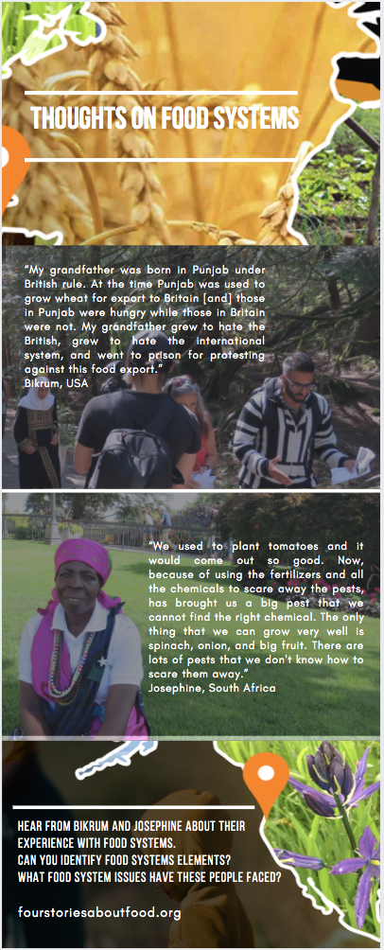
Activity:
Let’s hear from project participants. Can we identify the connections to food systems?
*Infographic at left available on website

Slide 7
Follow the project!
fourstoriesaboutfood.org

