Slide 1
THE FOUR SETTINGS
Overview Pathway

Slide 2
The Four Stories About Food Sovereignty project includes small-scale farmers and food producers, food-security workers and researchers from four countries: Canada, Colombia, South Africa and Jordan.

Slide 3
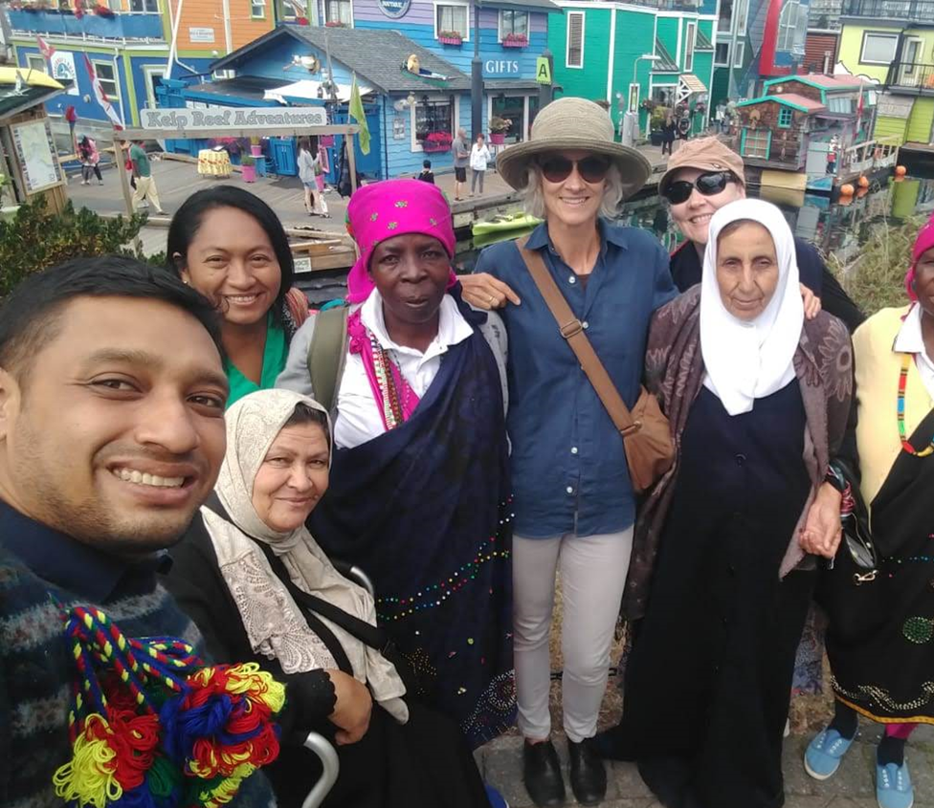
Let’s learn about where the project participants come from
and who they are.

Slide 4
The Four Settings:
Jordan: Palestinian refugee community in Baqa’a Camp; Syrian refugees and low-income Jordanians, in Irbid
South Africa: urban farmers in Hillbrow, Johannesburg; rural farmers in N’wamitwa
Indigenous Canada: T’Sou-ke Nation in Vancouver Island (Sooke), BC
Indigenous Colombia: Wayuu Indigenous people in La Guajira, Colombia

Slide 5
Indigenous Canada: T’Sou-ke Nation in Vancouver Island (Sooke), BC

Slide 6
T’Sou-ke (pronounced SOWK) Nation is a west coast Indigenous community living on T’Sou’ke territory on Vancouver Island.
Located just outside of the city of Victoria in the town now known as Sooke, T’Sou-ke Nation Elders and knowledge keepers are key participants in this project.
T’Sou-ke Nation is known for its food and energy sovereignty and is a leader in green technologies, such as solar power.

Slide 7
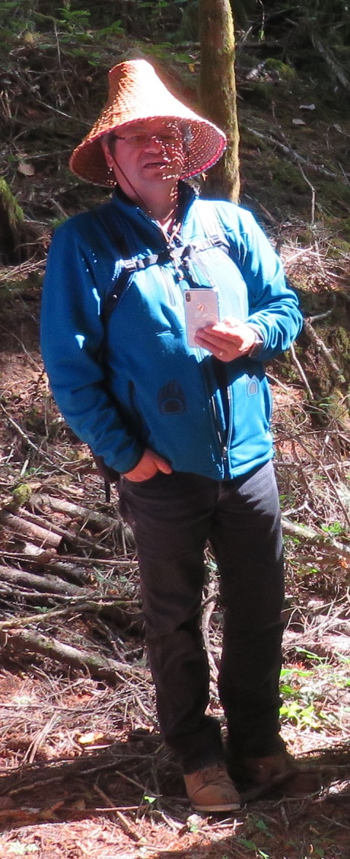
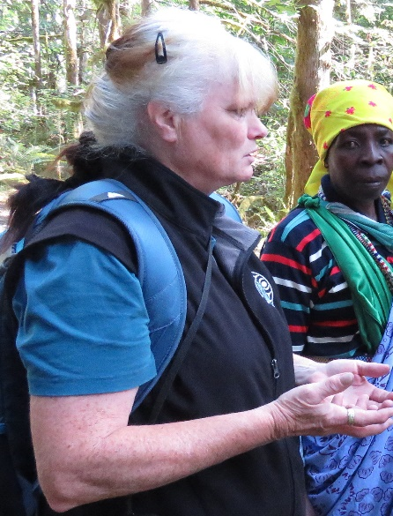
Meet…
Chief Gordon Planes
Chief Planes (pronounced PLAN-iss), an elected chief and hereditary leader of T’Sou-ke Nation.
He has strong interests in T'Sou-ke arts and culture, Indigenous land rights and governance, traditional ecological knowledge, and alternative energy systems.
Christine
Christine is a specialist in Indigenous plants used for medicines and foods.
She has a deep knowledge of the cultural uses of plants and cultural practices that have been lost as a result of loss of land.

Slide 8
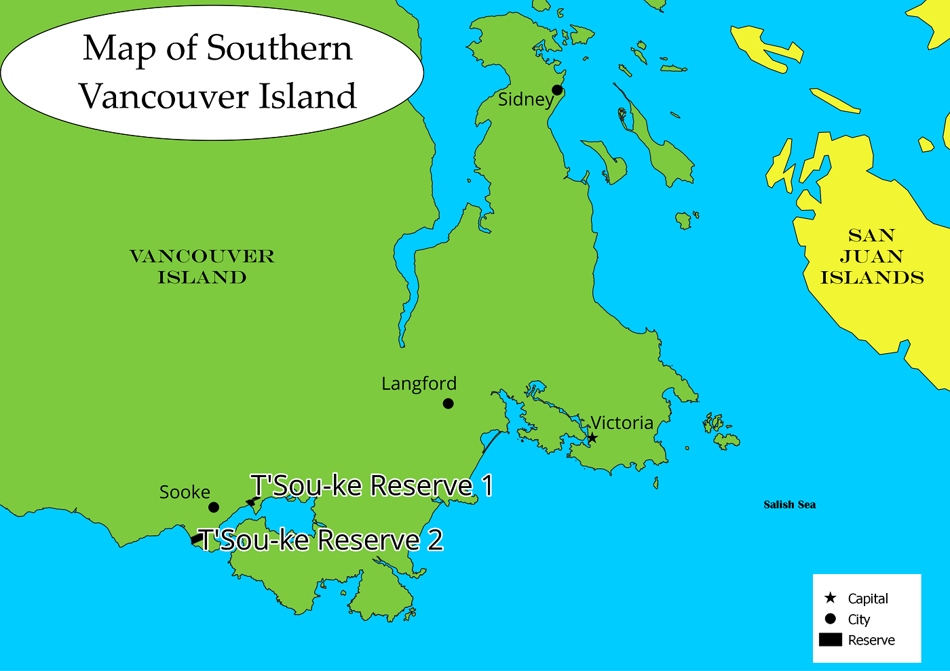

Slide 9
Indigenous Colombia: Wayuu Indigenous people in La Guajira, Colombia

Slide 10
The Indigenous Wayuu (pronounced Why-you) community participating in this project is located in northern Colombia in a region called La Guajira.
Wayuu pastoralists (livestock farmers) in Colombia are embroiled in multiple crises as they face severe drought, fight to protect their lands and herds from the massive Cerrejon coal mine on their territories, and confront refugee flows from neighbouring Venezuela.

Slide 11
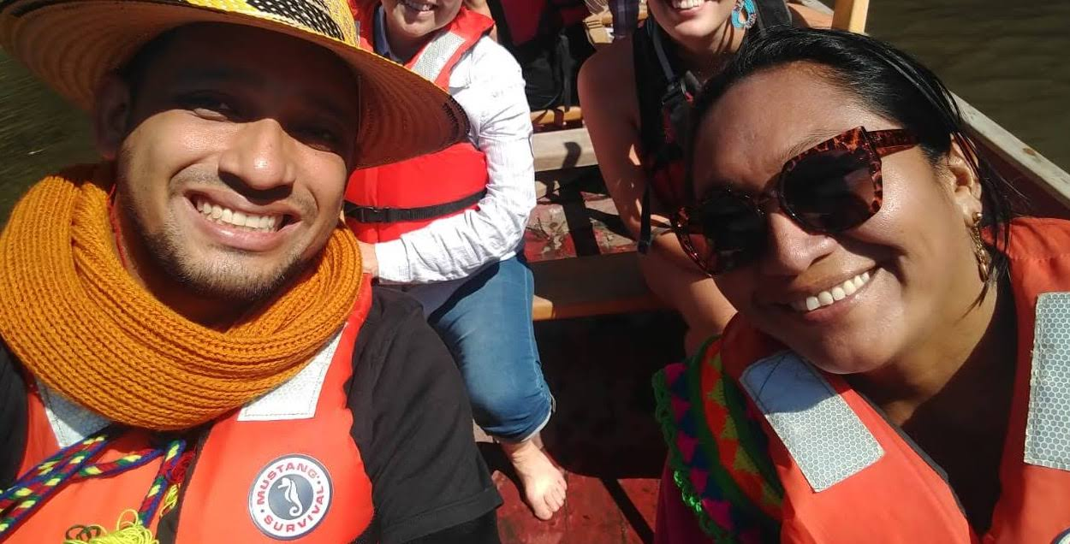
Meet…
Miguel
Miguel has taken an active interest in the situation of Wayuu Indigenous women.
He is an Indigenous and community communicator, publicist, documentary filmmaker and photographer.
Jakeline
Jakeline has participated in strategic alliances of communities and Wayuu organizations. The main objective of these are to make visible the situation of violation of the human rights of the Wayuu people in La Guajira.

Slide 12
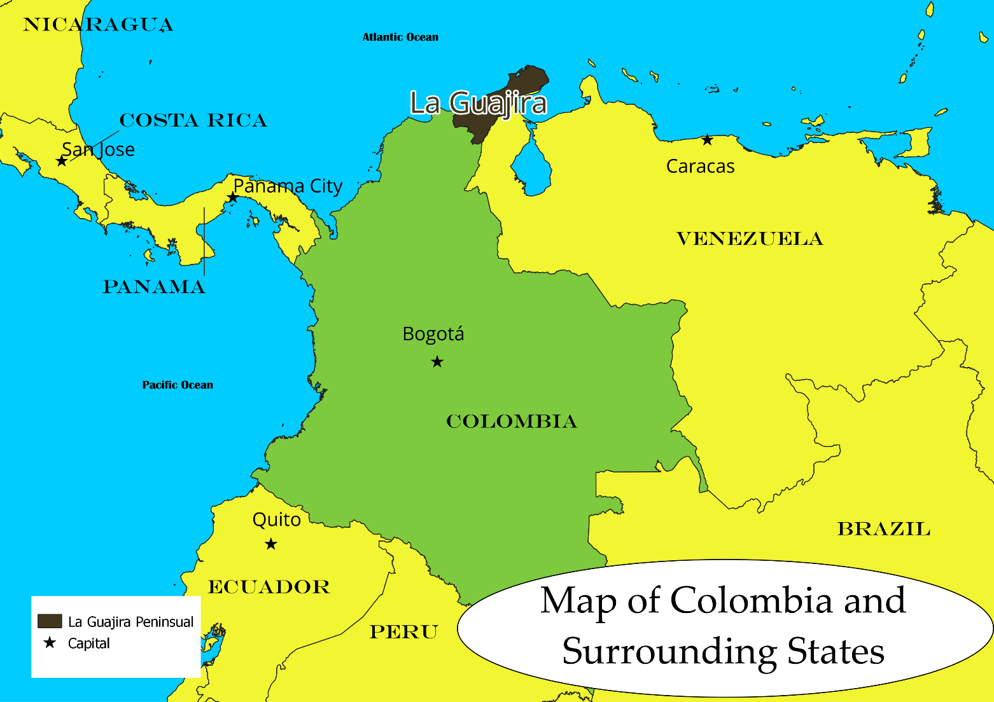

Slide 13
Jordan:
Palestinian refugee community in Baqa’a Camp and Syrian refugees and low-income Jordanians, in Irbid

Slide 14
Baqa’a is the largest refugee camp in Jordan. It is about 20km north of Amman.
According to the UN Relief and Works Agency (UNRWA), the Baqa’a camp was set up as an emergency location in 1968 for people leaving the West Bank and Gaza Strip during the time of the Arab-Israeli war.

Slide 15
Palestinian and Syrian refugees in Jordan
face food challenges in this unstable region which is increasingly ravaged by climate change.
Residents of the Baqa’a camp and refugee camp in Irbid are seeking to assert cultural identities by rebuilding fractured food cultures in exile under extreme water and land scarcities, including rising temperatures and shifting seasons.

Slide 16
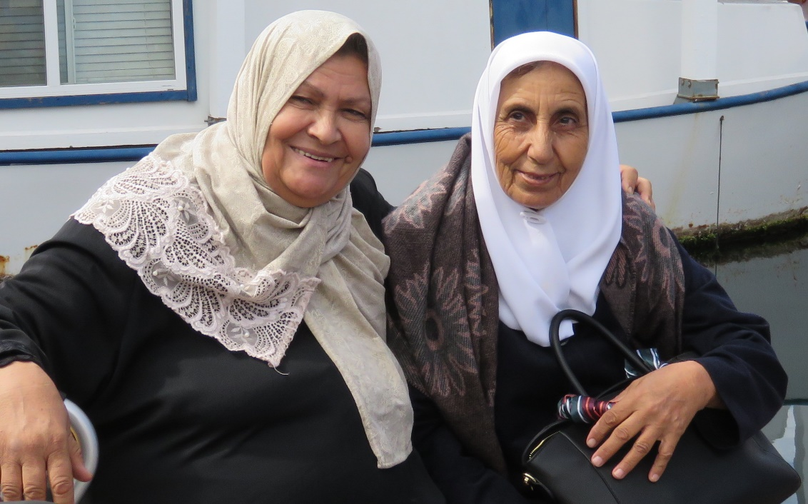
Meet…
Aysheh
A resident of Baqa’a, Aysheh started a grain mill as an income-generating project for her family. The mill is now a community-supporting enterprise that helps to keep Palestinian food culture alive in the Baqa’a camp.
The grains used in Aysheh's mill are of a locally-grown, heritage variety wheat adapted to water scarcity and favoured for flavour and texture.
Fatima
Fatima is a retired school principal, a productive market gardener and agricultural innovator.
In 2009 Fatima founded the Kananat Organization to help landless local people learn to use rooftops for at-home food-production.
Fatima now shares insights into effective food security/sovereignty activities to empower the most vulnerable, including recent refugees.

Slide 17
Meet…
Imad
Imad is an agricultural engineer at the National Agricultural Research Center in Amman and also works with the UN Food and Agriculture Organization.
He has specific interests in environmentally and socially sustainable horticulture and water conservation and has extensive knowledge of traditional water and land stewardship practices.

Slide 18
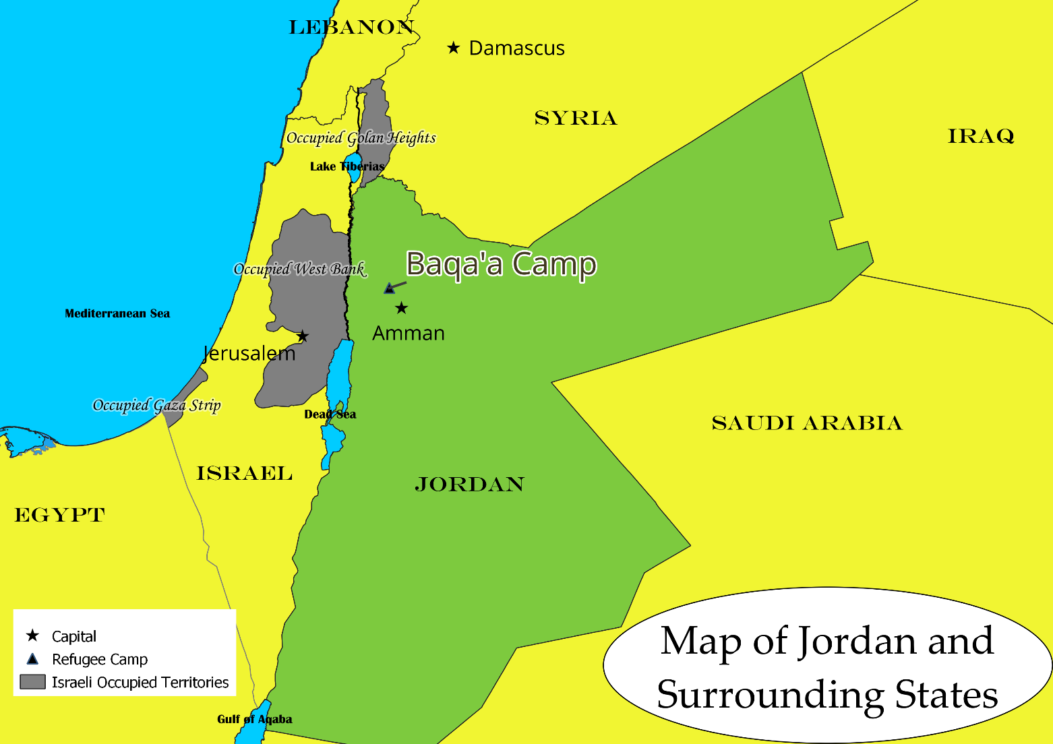

Slide 19
South Africa: urban farmers in Hillbrow, Johannesburg; rural farmers in N’wamitwa

Slide 20
Four Stories About Food Sovereignty works with three generations of female farmers in rural Nwamitwa, South Africa, about 450km north of the city of Johannesburg.
These women, many older than 60, struggle to create community and dignified livelihoods amid structural unemployment and the effects of climate change.
We also work with urban farmers who farm on rooftops and in abandoned spaces in the crowded inner-city area of Hillbrow in Johannesburg.

Slide 21
Members of the Hleketani Community Garden in rural N’wamitwa (featured in the documentary film The Thinking Garden), these women have been succeeding at providing the local community with nutritious, affordable, accessible vegetables for more than 25 years in the face of enormous challenges, from the HIV/AIDS pandemic to devastating droughts.

Slide 22
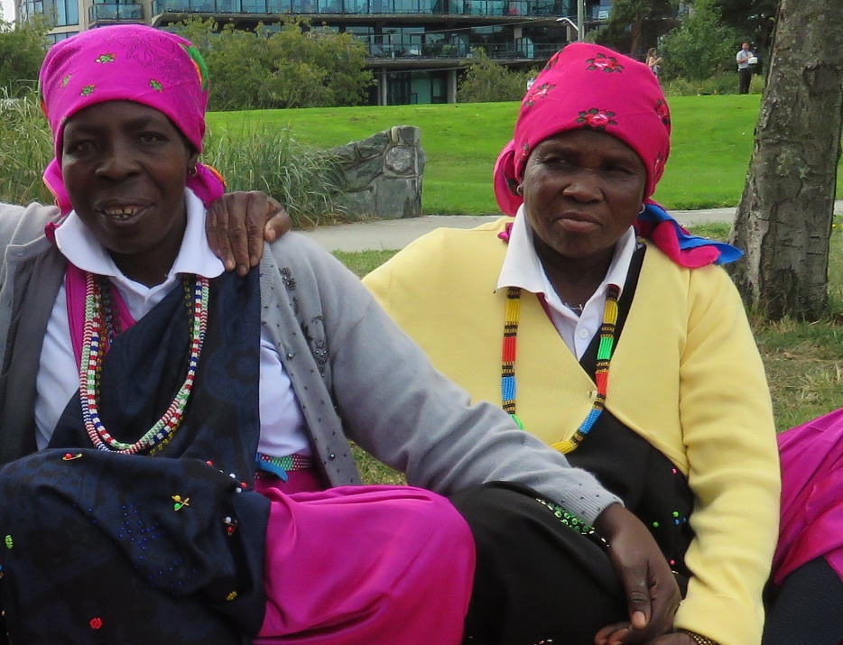
Meet…
Josephine
Josephine is a founding farmer and board member at Hleketani Community Garden.
With fellow community members she has weathered political upheaval, the crushing HIV/AIDS epidemic, damaging shifts of the global economy, drought and other deepening effects of climate change.
Mphephu
Mphephu is a founding farmer and board member at Hleketani Community Garden.
She often leads colleagues in rousing praise songs, and is a strong representative of the farm to government agencies; she once camped out at the electricity utility's office when staff ignored the farm's needs.

Slide 23
Meet…
Basani
Basani is a long-time research assistant in the South African research. She is a student of Media and Communications at Boston College in Pretoria, South Africa.
Basani served as assistant director of the documentary film The Thinking Garden and is specializing in film for development in her studies.

Slide 24
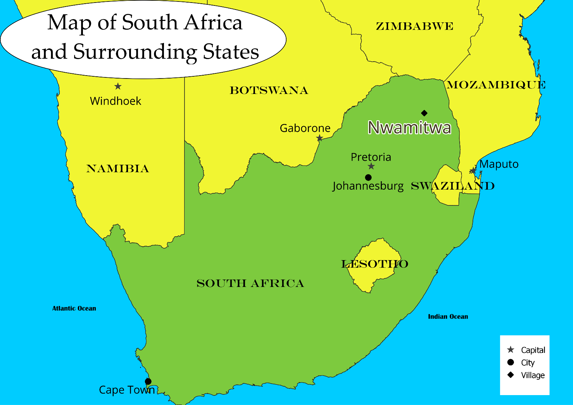

Slide 25
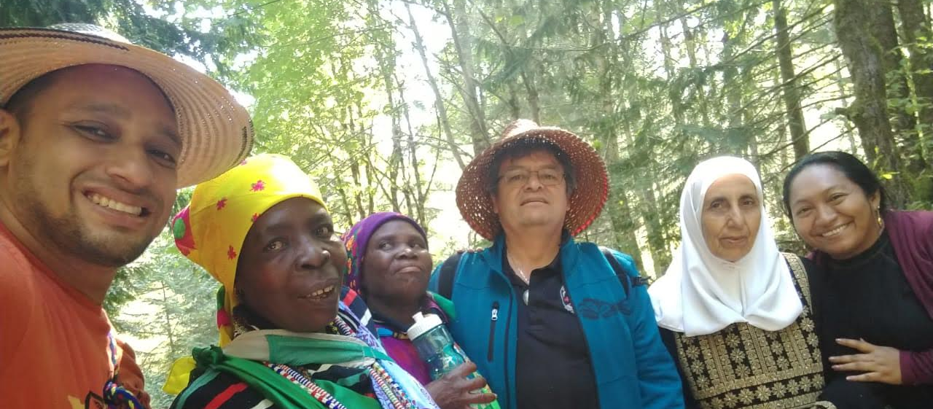
Let’s explore a bit more about the settings
and the project participants.
https://www.youtube.com/channel/UCvwRC-qe2OHyoohjRBRSSdQ/playlists

Slide 26
Follow the project!
fourstoriesaboutfood.org

